Slide 1


DATA221 Intro Machine Learning Backpropagation, stochastic gradient descent
William Trimble
Winter 2023

Slide 2
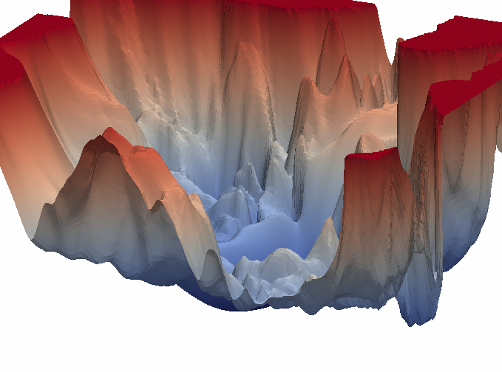

Slide 3
Difficulties with training models
I have a potentially expensive-to-evaluate loss function.
Why is it expensive? looping over all the training data.
Gradient descent alone will find local minima. I have to take steps against the gradient sometimes to escape.
Adding random vectors to my position to try to escape from local minima is extremely inefficient, but what can I do? Markov chain monte carlo.
Example: single-letter-substitution ciphers have 26! (4 x 10²⁶ ) keys, but they are easy to solve; the enigma had many many fewer states (~10²⁰) but was harder to solve.

Slide 4
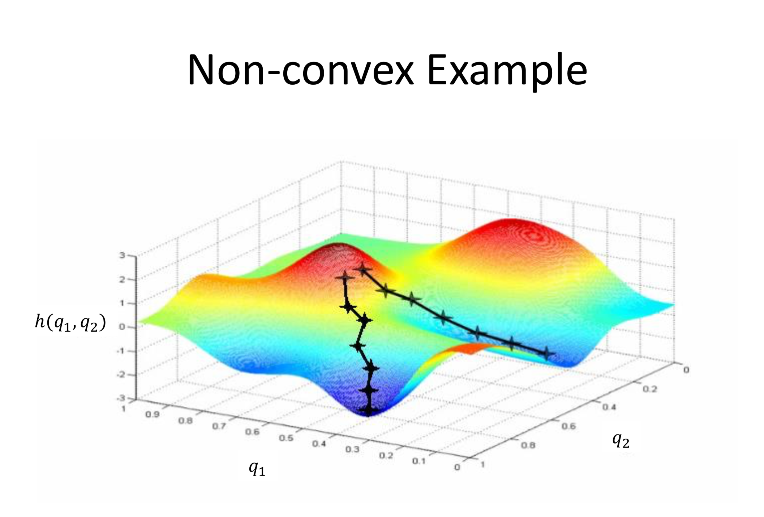
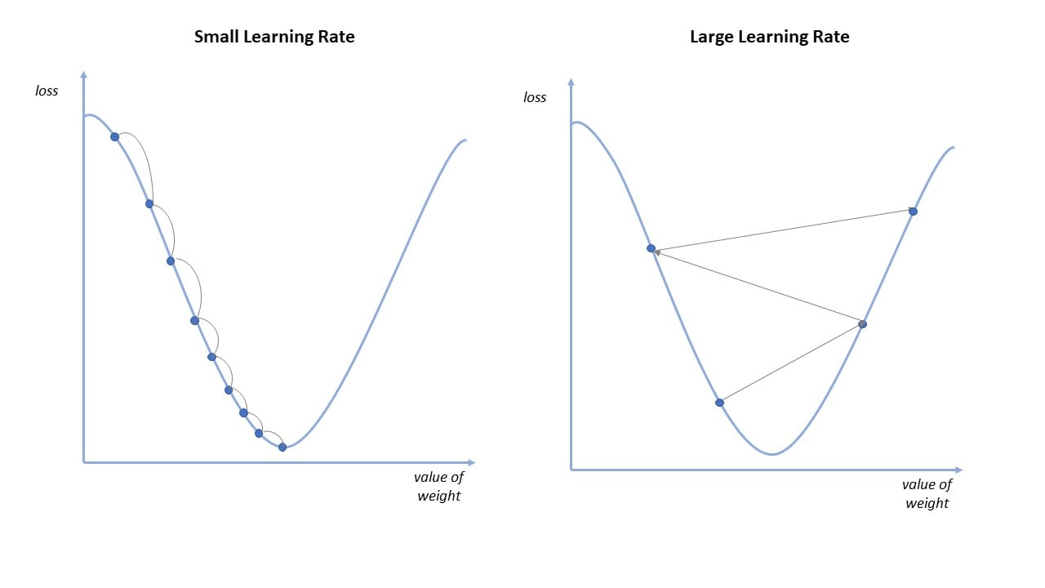
Gradient descent:
learning
rate
gradient of the loss function w/r/t w
New weight
step n
New weight
step n

Slide 5
Gradient descent:
number of weights
number of weights
number of weights
number of weights * number of outputs

Slide 6
Gradient descent:
number of weights
number of weights
number of weights
number of weights
But the loss function usually is a sum over the number of training points

Slide 7
Basic neural network
Input layer (p)
Hidden layer (n₁)
Output layer (d)
1
z₁
y₁
X₁
z₂
y₂
X₂
z₂
y₂
X₃
z₃
y_{d}
X_{r}
w (n₁ x r)
w (d x n₁)

Slide 8
Stochastic gradient descent
loss function is expensive because it has all the data
gradient descent gets stuck in local minima
Replace the full gradient of the loss function w/r/t model parameters with an approximation of the gradient
Use the gradient w/r/t just one of the training points; iterate over all the data; this adds randomness and mitigates the local minimum problem.
Training on subsets of the data “batches” mitigates both of these problems: it breaks local minima that are present in only some of the data, and allows more optimization steps to happen faster.
Cost? Low ratio of steps to data; only see each data point some of the time.
Gradient descent on random (or permuted) subsets acts like a randomized average gradient.

Slide 9
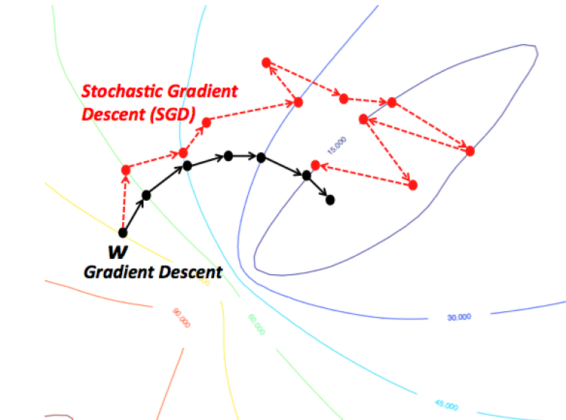
SGD
gradient descent (full gradient)
stochastic gradient descent (one point at a time)
minibatch gradient descent (middle ground)
Need a piece of jargon:
“epoch” is the amount of training needed to see each item of training data on average once.

Slide 10
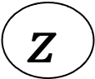
One neuron… logisitic classifier…
1
w₀
X₁
w₁
X₂
w₂
Σ
f
$$z$$
w₃
X₃
w_{p}
X_{p}

Slide 11
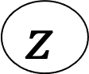
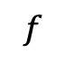
One neuron… logisitic classifier…
_{inputs}
_{weights}
_{activation}
_{function}
_{“activation”}
1
w₀
Σ
$$f$$
$$z$$
w₁
X₁

Slide 12
What do the derivatives of this look like?

Slide 13
Finding the gradient of the neural network loss
Input layer (p)
Hidden layer (n₁)
Output
layer
Training labels
1
z₁
y₁
X₁
z₂
y₂
X₂
z₂
y₂
X₃
z₃
y_{d}
X_{r}
w (n₁ x r)
w (d x n₁)

Slide 14
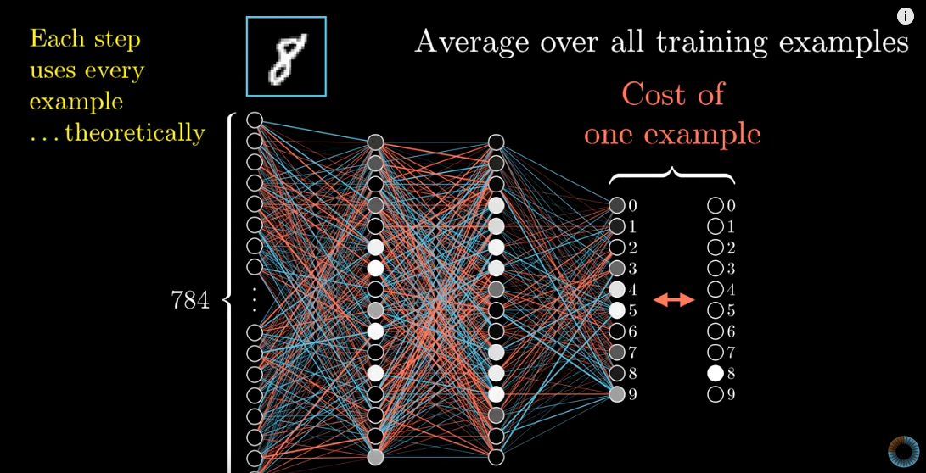
https://www.youtube.com/watch?v=Ilg3gGewQ5U What is backpropagation really doing? | Chapter 3, Deep learning
3blue1brown

Slide 15
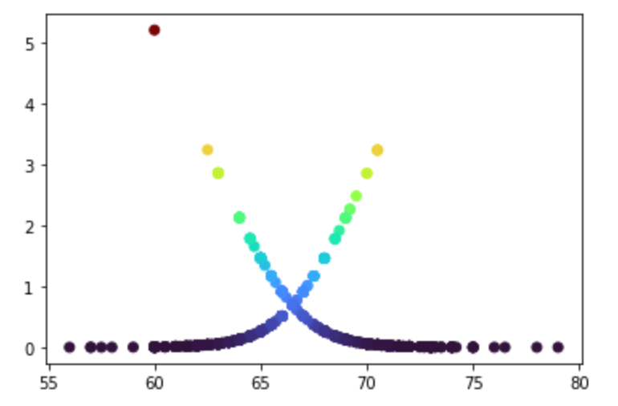
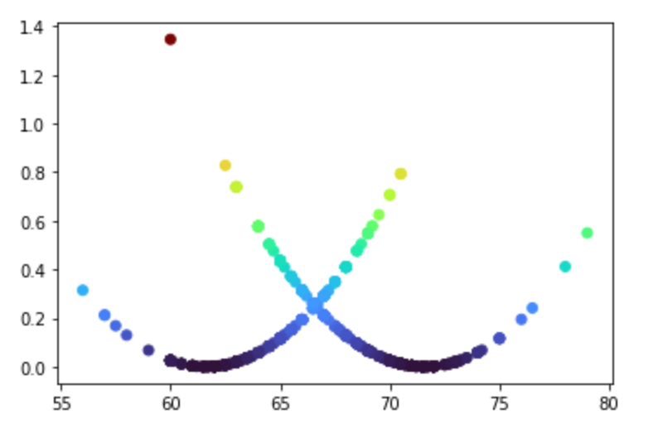
Logistic loss function on Galton height data
SSE loss function
Logistic loss function
Height (in)
Height (in)

Slide 16
Deep neural network
Input layer (p)
Hidden layer (n₁)
Hidden layer (n₁)
Output
layer
Training labels
1
z₁
z₁
y₁
y₁
Like FFT, I can reuse computations that I’ve already done, and evaluate the gradient with no more effort than a single pass through the network.
X₁
z₂
z₂
y₂
y₂
X₂
z₂
z₂
y₂
y₂
X₃
z₃
z₃
y_{d}
y_{d}
X_{r}
w (n₁ x r)
w (n₂ x n₁)
w (d x n₂)

Slide 17
Deep neural network backpropagation
Like FFT, I can reuse computations that I’ve already done, and evaluate the gradient with no more effort than a single pass through the network.
Input layer (p)
Hidden layer (n₁)
Hidden layer (n₁)
Output layer (d)
1
z₁
z₁
y₁
X₁
z₂
z₂
y₂
X₂
z₂
z₂
y₂
X₃
z₃
z₃
y_{d}
X_{r}
w (n₁ x r)
w (n₂ x n₁)
w (d x n₂)

Slide 18
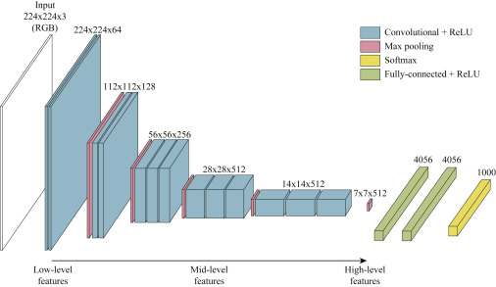
This convolutional neural network.. How many parameters does it have?
150k

Slide 19
This convolutional neural network.. How many parameters does it have?
150k
There may be only a few times more weights than inputs.
Possible to succinctly communicate the parameters of the model…

Slide 20
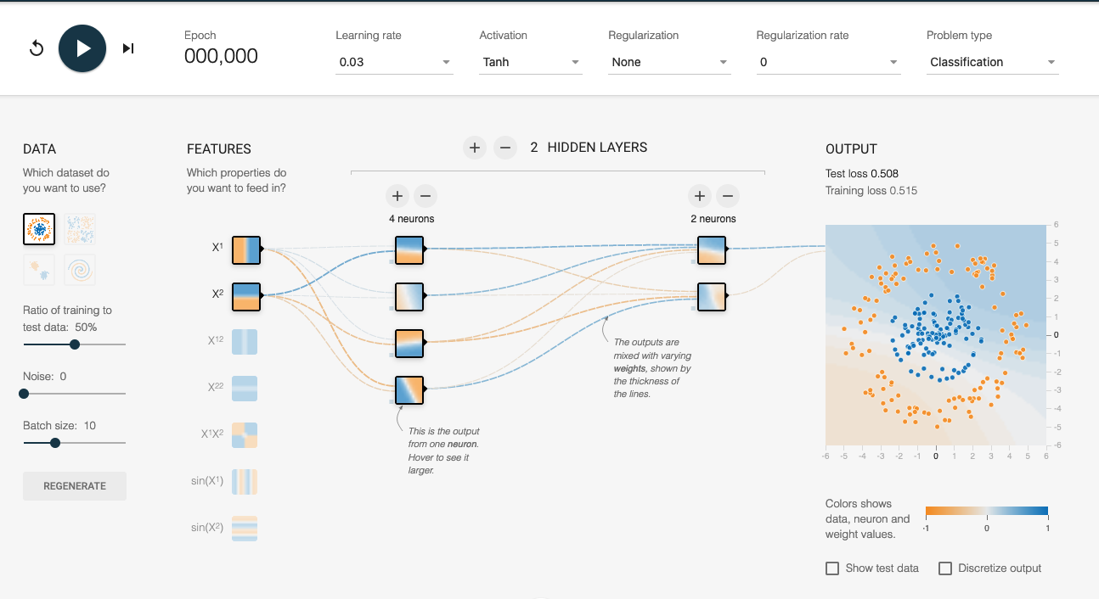
https://playground.tensorflow.org

